Slide 1












French Revolution
The course of the revolution and the impacts it had on the society

Slide 2

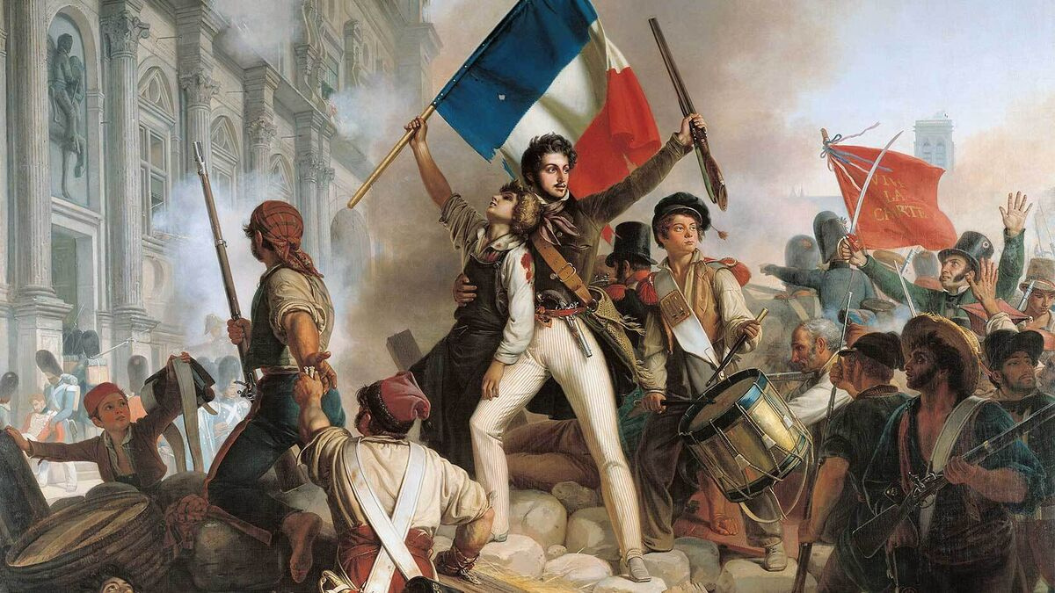

Course of the Revolution
Estates General and National Assembly (1789):
Commoners declared the National Assembly, seeking political change.
The Estates General represented three estates: clergy, nobility, and commoners.
Storming of the Bastille (July 14, 1789):
Parisian uprising resulted in the capture of the Bastille.
Symbolic victory against oppression, celebrated as Bastille Day.
Declaration of the Rights of Man and of the Citizen (1789):
National Assembly adopted this influential document.
Asserted citizens' rights and promoted liberty, equality, and fraternity.

Slide 3





The course of the Revolution
Reign of Terror (1793-1794):
Committee of Public Safety, led by Maximilien Robespierre, gained power.
Mass executions of perceived enemies, including King Louis XVI and Queen Marie Antoinette.
Rise of Napoleon Bonaparte (1799):
Napoleon staged a coup and became First Consul.
Later declared himself Emperor Napoleon I in 1804.

Slide 4
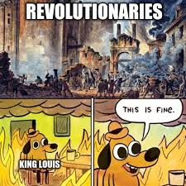

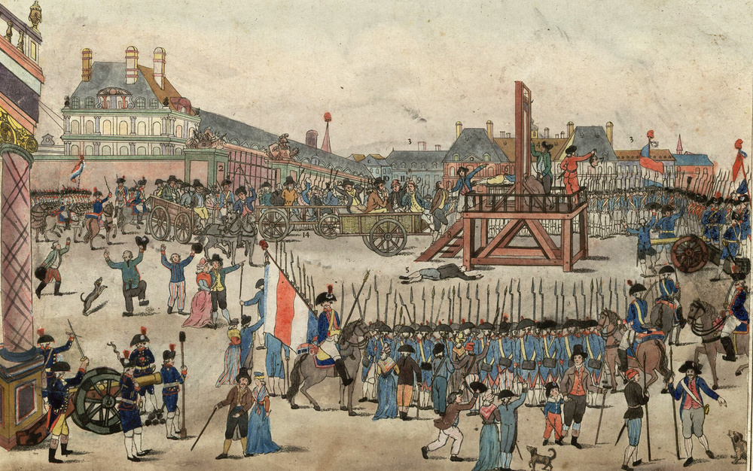
Impacts the revolution had on the Society
Rise of Republicanism: Replaced monarchy with a democratic government, emphasizing people's sovereignty and participation in politics.
Enlightenment Ideals: Influenced by Enlightenment principles, the revolution promoted liberty, equality, and reason, enshrined in the Declaration of the Rights of Man and of the Citizen.
POSITIVE IMPACTS
Abolition of Feudalism: Ended the feudal system, dismantling privileges of the nobility and clergy, leading to a more equitable distribution of land and wealth.

Slide 5


Negative Impacts
REIGN OF TERROR
SOCIAL AND ECONOMIC DISRUPTION
RADICALIZATION AND EXTREMISM
WARS AND CONFLICTS
LOSS OF CULTURAL HERITAGE
The period of the Reign of Terror led to mass executions, political repression, and a climate of fear and instability.
The revolution caused economic instability and job losses due to the abolition of feudalism and redistribution of land, impacting both the aristocracy and common people.
Extreme political factions, such as the Jacobins, implemented authoritarian measures, suppressed dissent, and deepened social divisions.
-Revolutionary zeal resulted in the destruction and vandalism of cultural and historical artifacts associated with the monarchy and the Catholic Church, leading to the loss or damage of valuable cultural heritage.
he revolution sparked conflicts within France and with other European powers, leading to years of warfare, instability, and loss of life.
Yeah, you. why are you reading this? PAY ATTENTION!!1!

Slide 6


Around
2,500,000
Were killed. Anyone that were against the French leader was guillotined; which meant they were beheaded.
Quote
"The secret of freedom lies in educating people, whereas the secret of tyranny is in keeping them ignorant." - Maximilien de Robespierre

Slide 7
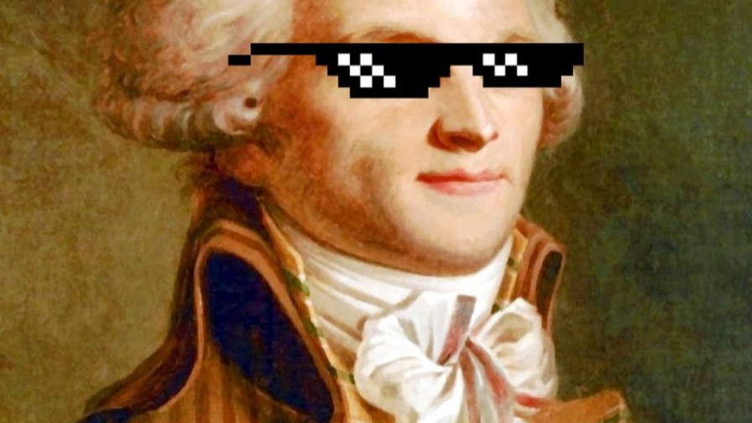
Quote
"The secret of freedom lies in educating people, whereas the secret of tyranny is in keeping them ignorant." - Maximilien de Robespierre

Slide 8



Quiz

Slide 9
Thank
you

